Slide 1

Viruses & Bacteria

Slide 2
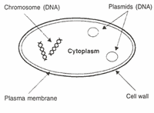
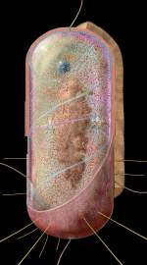
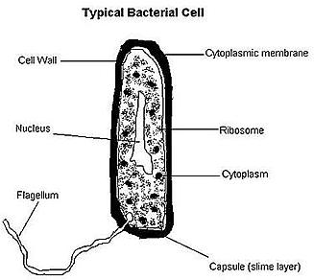

Bacteria Cell

Slide 3
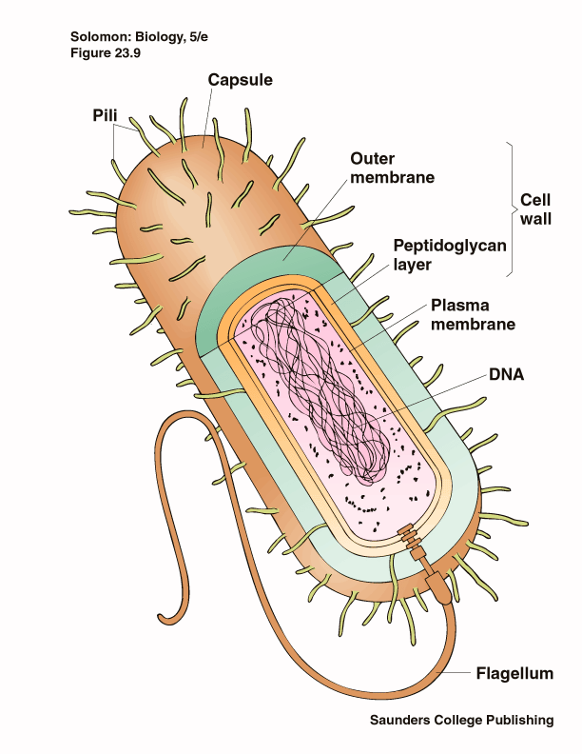
Prokaryotes
Cells that do not have a nucleus
Exist almost every where on earth
Grow in numbers so great you can see them with the unaided eye
Are placed in either the Eubacteria or the Archebacteria Kingdoms

Slide 4
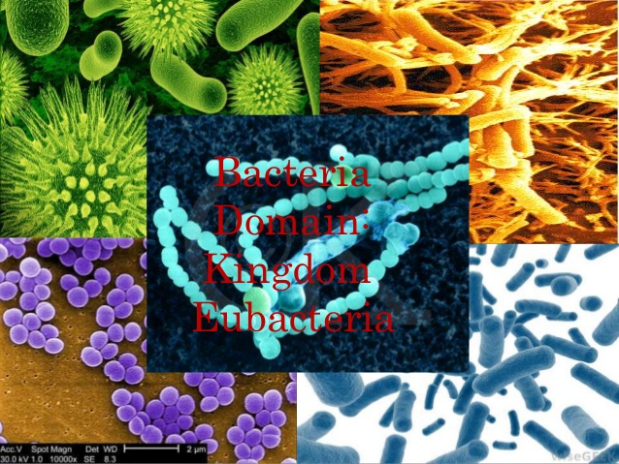
Eubacteria
Make up the larger of the two prokaryote kingdoms
Generally are surrounded by a cell wall composed of complex carbohydrates

Slide 5
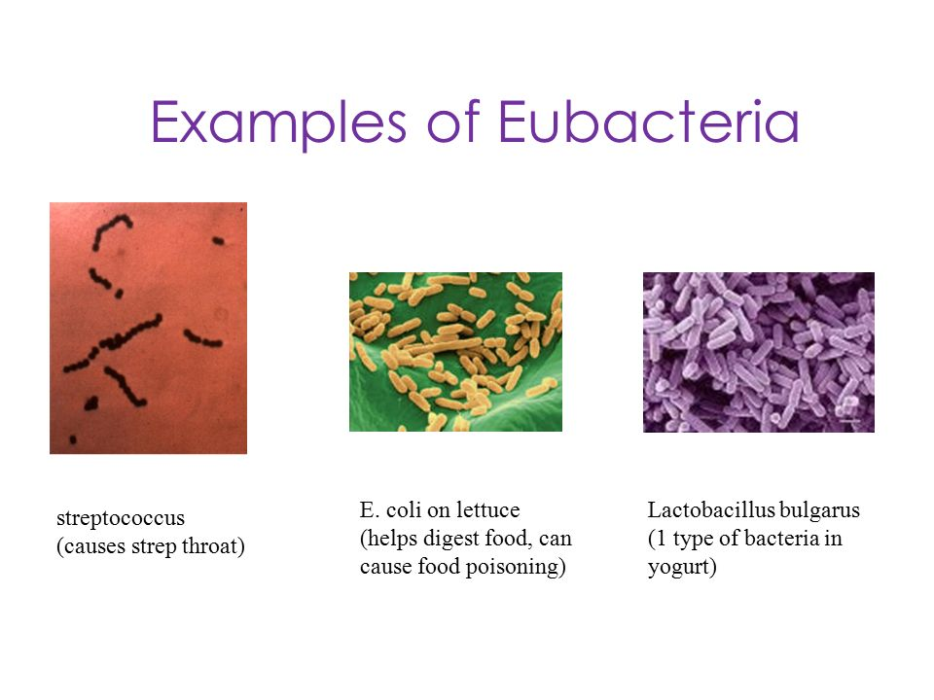

Slide 6
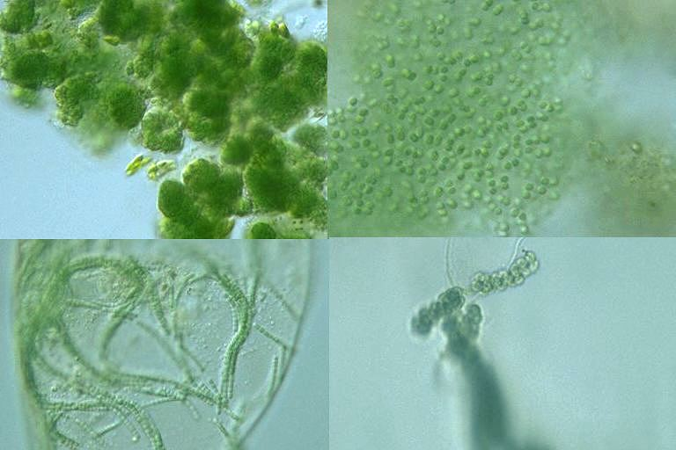
Cyanobacteria
Photosynthetic bacterium
Bluish-greenish color
Contain membranes that carry out the process of photosynthesis
Do not contain the same type of chloroplasts as plants do
This bluish-greenish algae can be found nearly everywhere on earth.
Can survive in extremely hot environments and even extremely cold environment

Slide 7
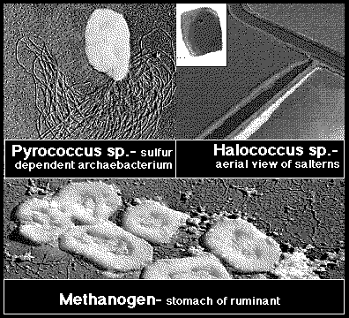
Archaebacteria
Lack important carbohydrate found in cell walls
Have different lipids in their cell membrane
Different types of ribosomes
Very different gene sequences
Archaebacteria can live in extremely harsh environments
They do not require oxygen and can live in extremely salty environments as well as extremely hot environments.

Slide 8
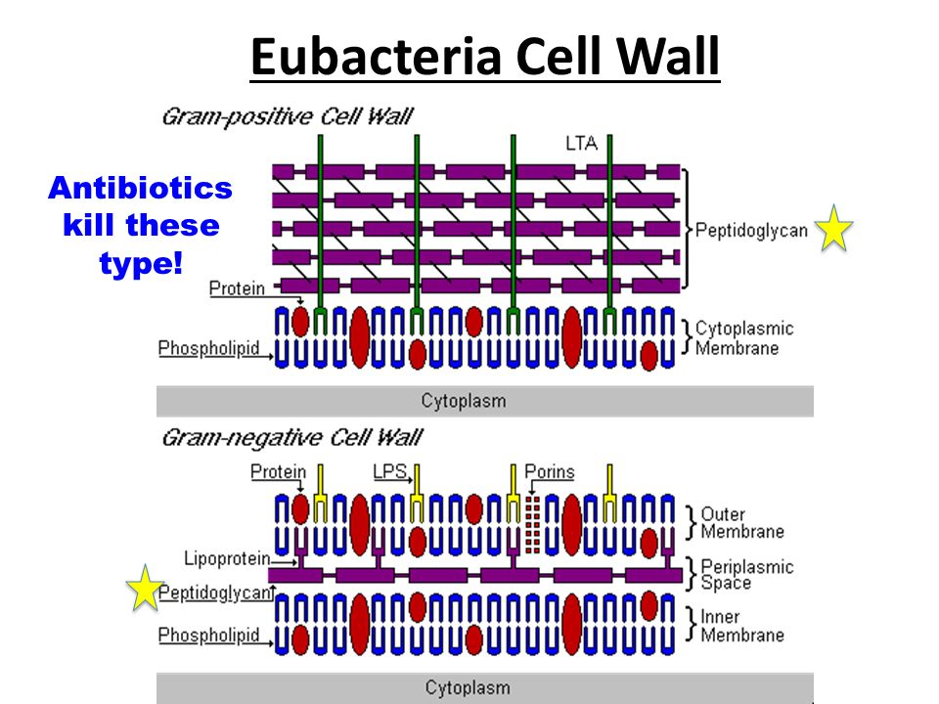
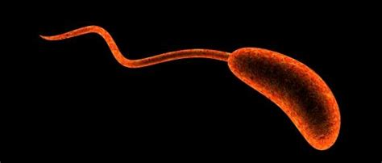
Identifying Prokaryotes
Cell Shape
Cell Wall
Movement

Slide 9
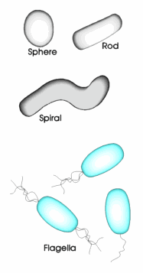
Bacterium Shapes
Cocci~ Sphere shaped bacteria
Bacillus~ Rod shaped bacteria
Spirrillium ~ Spiral shaped bacteria
Vibrions~ have the comma shape
Bacteria can have Flagella~
Leg-like structures that help to propel the bacterium.

Slide 10
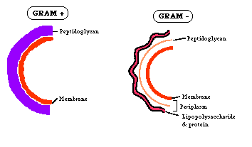
Cellular Walls
Chemical nature of a cell wall can be determined by Gram Staining
By finding out what color the cell produces when it is gram stained you can figure out the type of carbohydrates in the cell wall

Slide 11
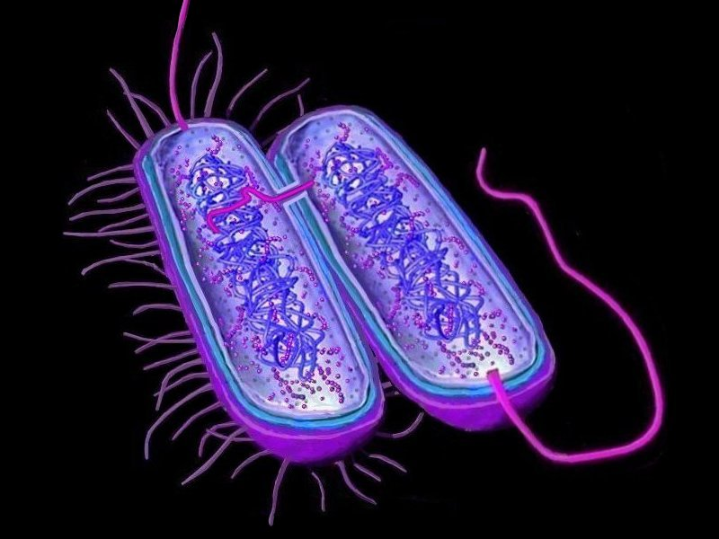
Movement
Flagella ~ Tail like structure the whips around to propel the bacterium
Cillia ~ Miniature flagella surround the cell that help to “swim”
Non motile ~ Sticky cillia like structures that keep the bacterium from moving

Slide 12
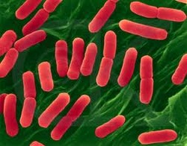
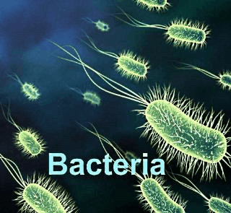
Bacteria and their energy
Autotrophs
Chemotrophs
Heterotrophs

Slide 13
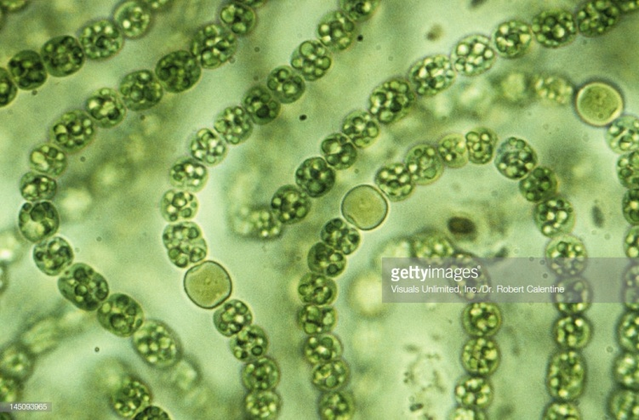
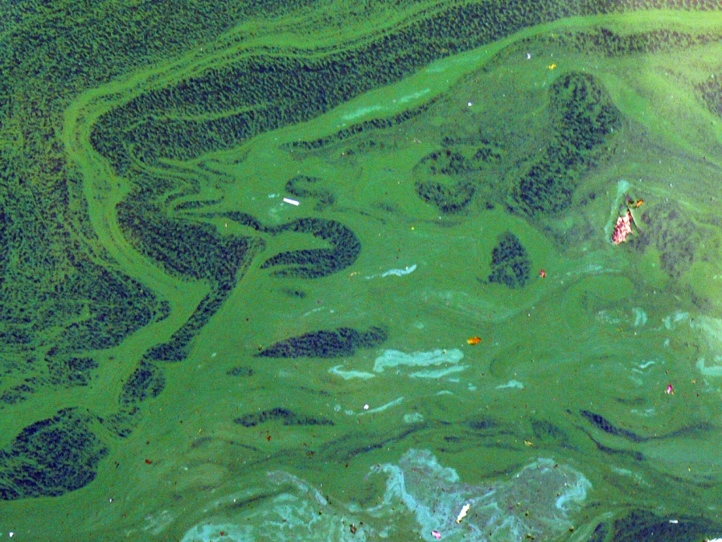
Autotrophs
Make their own energy
Using Solar energy
Es. Cyanobacteria

Slide 14
Chemotrophs
Make own Energy
Using Chemical energy
Es. Archaebacteria

Slide 15
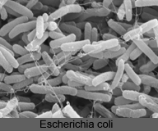
Heterotrophs
Obtain food
by eating
Es. E-coli

Slide 16
Bacteria Respiration
Obligate Anaerobes
Facultative Anaerobes
Obligate Aerobes
Live without Oxygen
Can live with or without oxygen
Cannot live without oxygen.

Slide 17
Bacteria Reproduction
Binary Fission
Conjugation
Trasduction
Trasformation
Spore Formation

Slide 18
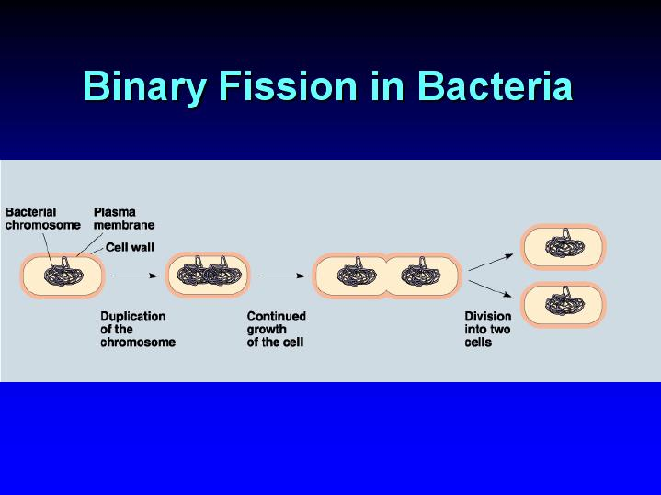
Cellular organism copies it’s genetic information then splits into two identical daughter cells

Slide 19
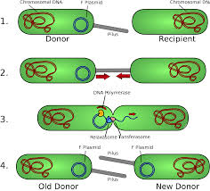
Conjugation
Bacterial conjugation is the transfer of genetic material (plasmid) between bacterial cells by direct cell-to-cell contact or by a bridge-like connection between two cells, conjugation is a mechanism of horizontal gene transfer as are transformation and transduction although
these two other mechanisms
do not involve cell-to-cell contact.

Slide 20
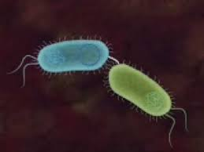
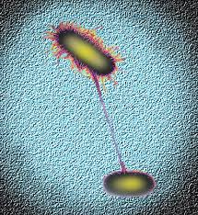
Bacterial conjugation is often regarded as the bacterial equivalent of sexual reproduction or mating since it involves the exchange of genetic material. During conjugation the donor cell provides a conjugative or mobilizable genetic element that is most often a plasmid.
The genetic information transferred is often beneficial to the recipient. Benefits may include antibiotic resistance or the ability to use new metabolites.
https://www.bing.com/videos/search?q=bacterial+coniugation&&view=detail&mid=D4B789BF9C04F9750FBDD4B789BF9C04F9750FBD&rvsmid=8B17D4B1D09CFB85581A8B17D4B1D09CFB85581A&FORM=VDQVAP

Slide 21
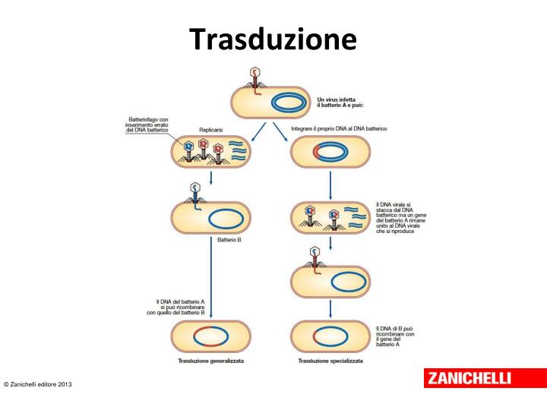
Transduction as a method for transferring genetic material
Transduction is the process by which DNA is transferred from one bacterium to another by a virus. It also refers to the process whereby foreign DNA is introduced into another cell via a viral vector. Transduction does not require physical contact between the cell donating the DNA and the cell receiving the DNA (which occurs in conjugation), and it is DNase resistant. Transduction is a common tool used by molecular biologists to stably introduce a foreign gene into a host cell's genome.

Slide 22
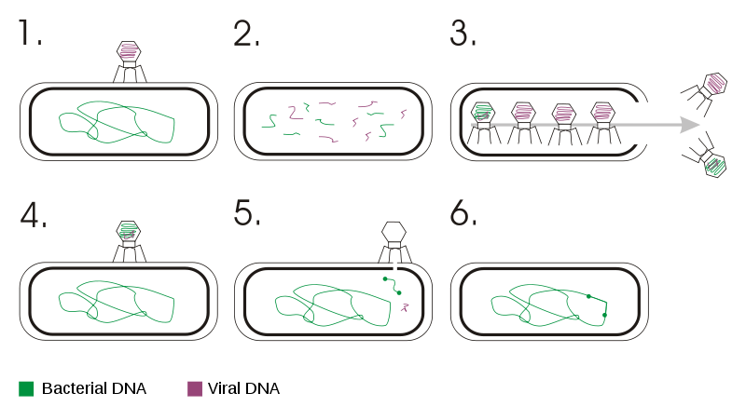
Transduction happens through either the lytic cycle or the lysogenic cycle. If the lysogenic cycle is adopted, the phage chromosome is integrated (by covalent bonds) into the bacterial chromosome, where it can remain dormant for thousands of generations. If the lysogen is induced (by UV light for example), the phage genome is excised from the bacterial chromosome and initiates the lytic cycle, which culminates in lysis of the cell and the release of phage particles. https://www.bing.com/videos/search?q=bacterial+transducyion&&view=detail&mid=EA981269AC0A39CF13E9EA981269AC0A39CF13E9&&FORM=VRDGAR

Slide 23
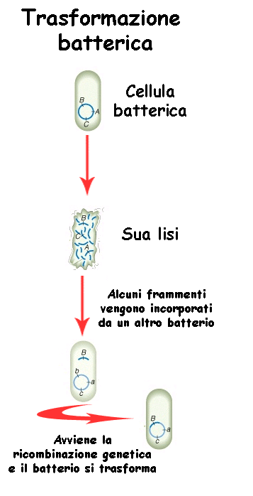
Transformation
In molecular biology, transformation is the genetic alteration of a cell, resulting from the direct uptake and incorporation of exogenous genetic material (exogenous DNA) from its surroundings and taken up through the cell membrane. Transformation occurs naturally in some species of bacteria, but it can also be effected by artificial means in other cells.
https://www.bing.com/videos/search?q=bacterial+transformation&&view=detail&mid=3738FB5F23C225596F483738FB5F23C225596F48&&FORM=VRDGAR

Slide 24
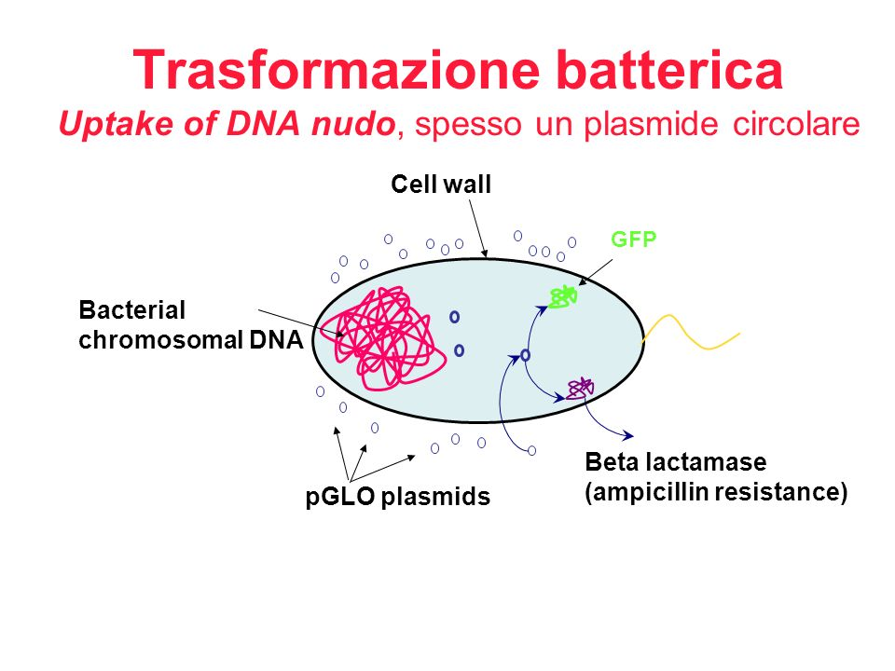
For transformation to happen, bacteria must be in a state of competence, which might occur as a time-limited response to environmental conditions such as starvation and cell density.
Transformation is one of three processes by which exogenous genetic material may be introduced into a bacterial cell, the other two being conjugation (transfer of genetic material between two bacterial cells in direct contact) and transduction (injection of foreign DNA by a bacteriophage virus into the host bacterium).

Slide 25
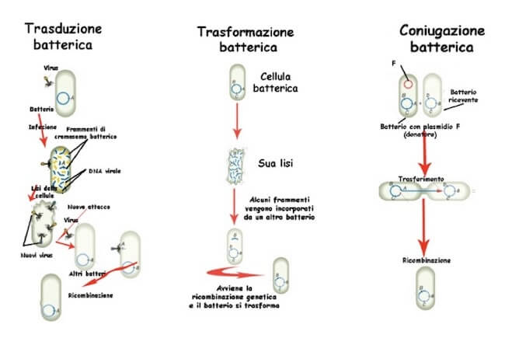
https://www.bing.com/videos/search?q=bacterial+conjugation+trasformation&&view=detail&mid=34D8FF58B1CA0A254BBF34D8FF58B1CA0A254BBF&&FORM=VDRVRV

Slide 26
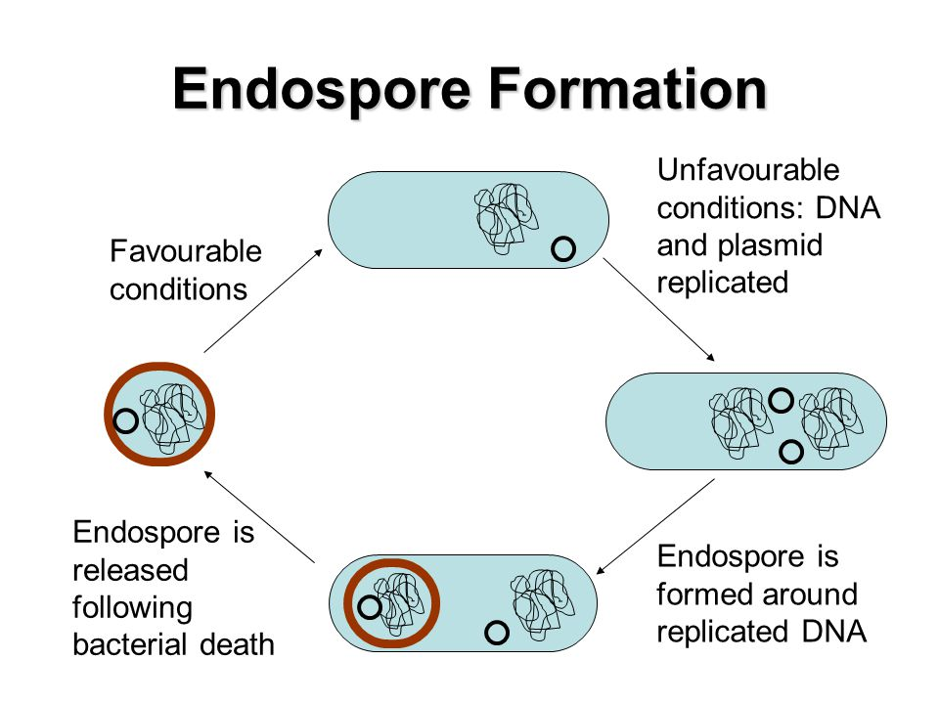
Spore forming bacteria are tougher than the average microscopic unicellular organism. These species, which include the genera Bacillus, Clostridium and Sporolactobacillus, can surround themselves with durable coats of protein that allow them to survive in hostile environmental conditions. As spores, bacteria can remain dormant for years, protected from stresses such as chemicals, heat, radiation and dehydration. When revived, however, these bacteria can cause a number of diseases, including botulism, anthrax, tetanus and acute food poisoning. https://www.bing.com/videos/search?q=spore+formation+in+bacteria&&view=detail&mid=1E2FA66F8DF3BB28F0231E2FA66F8DF3BB28F023&rvsmid=3438BC9E691BBB6E57583438BC9E691BBB6E5758&FORM=VDQVAP

Slide 27
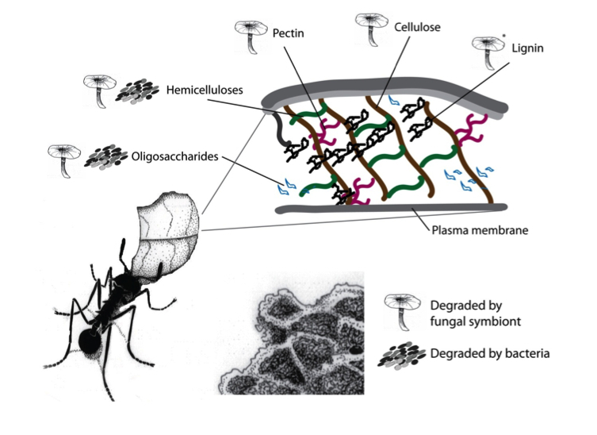
Symbiosis
Close relationship between to species in which at least one species benefits from the other
For example, Zoamastogopera, found in the stomach of termites, enable them to digest cellulose
Live together for LIFE
https://www.bing.com/videos/search?q=bacterial+symbiosis&&view=detail&mid=7D86E0ECD730CDB8E3BD7D86E0ECD730CDB8E3BD&rvsmid=807D09B4392133C253EE807D09B4392133C253EE&FORM=VDQVAP

Slide 28
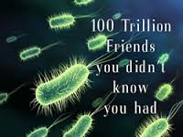
The human body carries about 100 trillion microorganisms in its intestines, a number ten times greater than the total number of human cells in the body. The metabolic activities performed by these bacteria resemble those of an organ, leading some to liken gut bacteria to a "forgotten" organ. It is estimated that these gut flora have around a hundred times as many genes in aggregate as there are in the human genome.

Slide 29
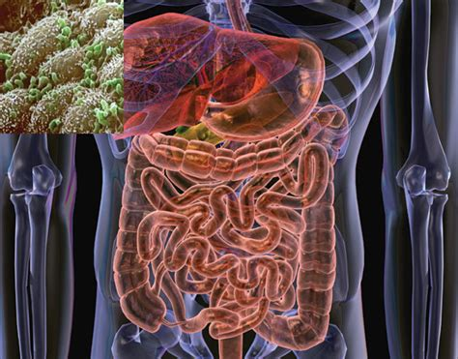
Gut flora or, more appropriately, gut microbiota, consists of a complex of microorganism species that live in the digestive tracts of animals and is the largest reservoir of microorganisms symbiotic to humans. In this context gut is synonymous with intestinal, and flora with microbiota and microflora. Gut microorganisms benefit the host by gleaning the energy from the fermentation of undigested carbohydrates and the subsequent absorption of short-chain fatty acids. Intestinal bacteria also play a role in synthesizing vitamin B and vitamin K as well as metabolising bile acids and sterols
https://www.bing.com/videos/search?q=gut+flora&&view=detail&mid=F1E7CAC7A8541CF2D66EF1E7CAC7A8541CF2D66E&&FORM=

Slide 30
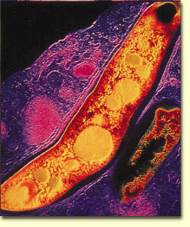
Parasitism
Bacteria exploit the host cell, injuring them
Eg. Mychobacterium tuberculosis

Slide 31
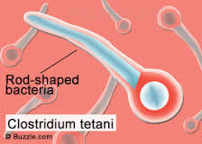
Pathogenic bacteria are bacteria that cause bacterial infection
Although most bacteria are harmless or often beneficial, several are pathogenic. One of the bacterial diseases with the highest disease burden is tuberculosis, caused by the bacterium Mycobacterium tuberculosis, which kills about 2 million people a year, mostly in sub-Saharan Africa. Pathogenic bacteria contribute to other globally important diseases, such as pneumonia, which can be caused by bacteria such as Streptococcus and Pseudomonas, and foodborne illnesses, which can be caused by bacteria such as Campylobacter, and Salmonella. Pathogenic bacteria also cause infections such as tetanus, typhoid fever, diphtheria and syphilis.

